Slide 1
HuskyADAPT Survey
By Joe Lawler
Notes:
Establishing an inclusive and sustainable design program for assistive technology
How do we pick projects for impact?
How do we reach out to need experts for project ideas and partnerships

Slide 2


Guiding Questions
How could the survey on the HuskyADAPT website be improved?
What should be added to the website to make the survey easier to find and more descriptive?

Slide 3
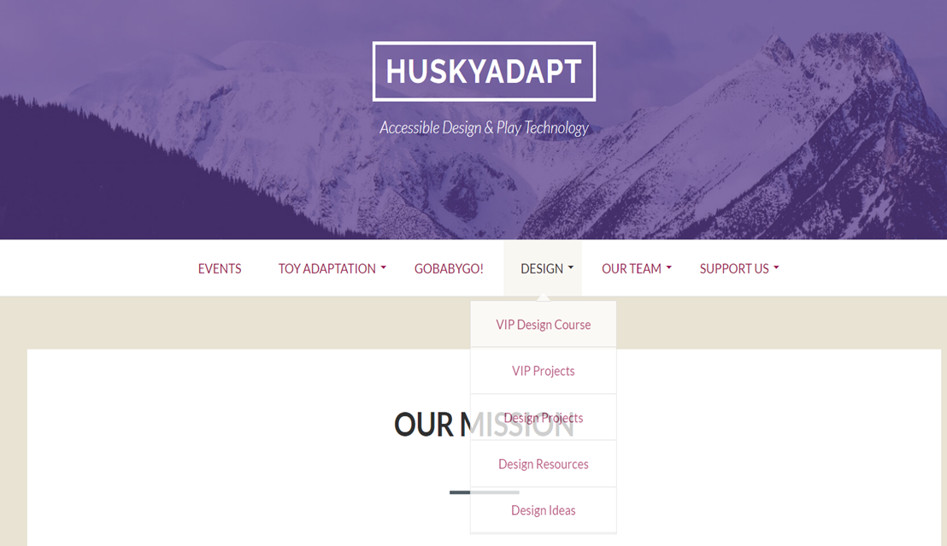
Current State of Website
Only accessible from Home page drop down menu
No link provided from Design Section to Survey

Slide 4

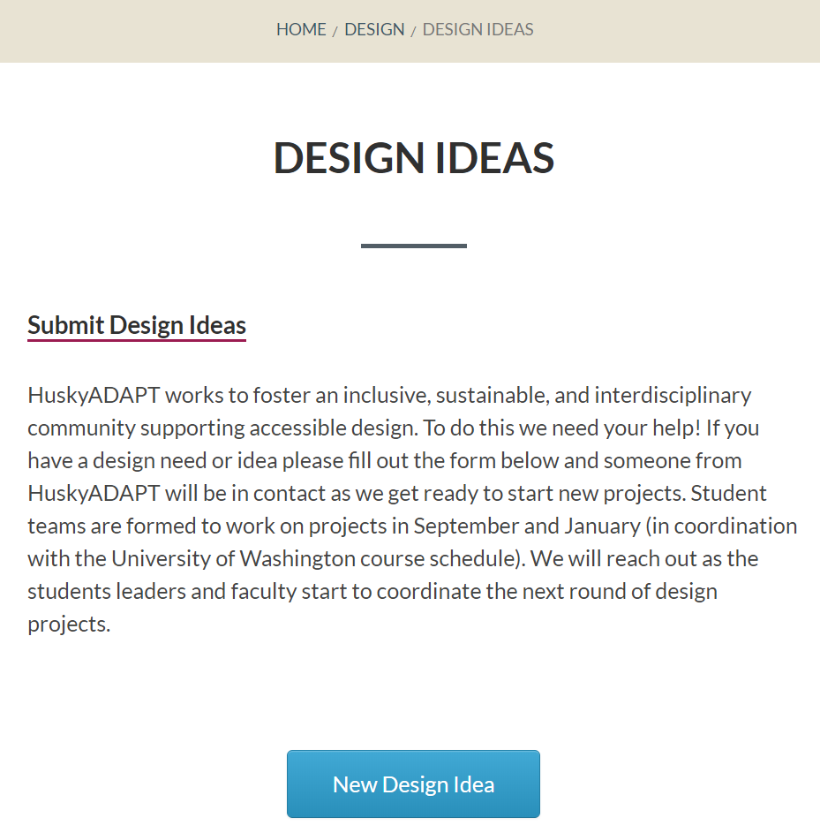


Design Ideas page
Notes:
Again fix date here; other than that I thought this paragraph was great

Slide 5
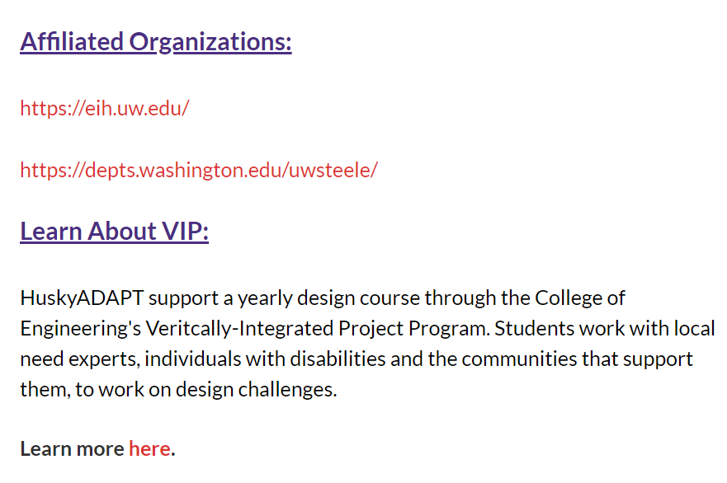
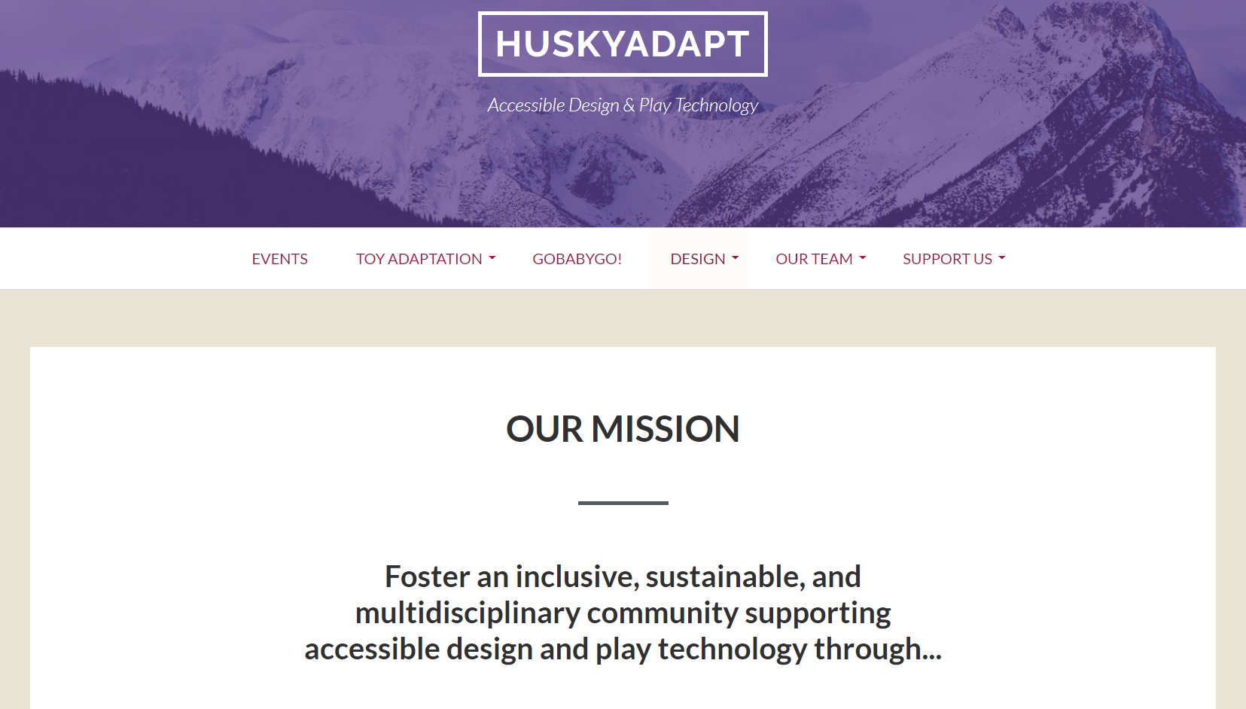
What could be added to the website to make the survey easier to find?
Link directly from homepage
HuskyADAPT is now accepting Design Ideas for the 2018-2019 school year! Click here to share yours.
Link from bottom of Design page

Slide 6
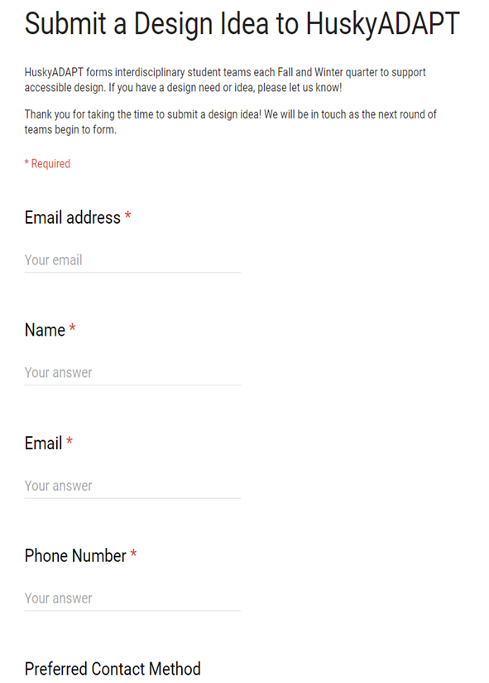
Current State of Survey
Notes:
Quick things:
-List email twice; need to correct the information on the top; add something to set expectations here

Slide 7
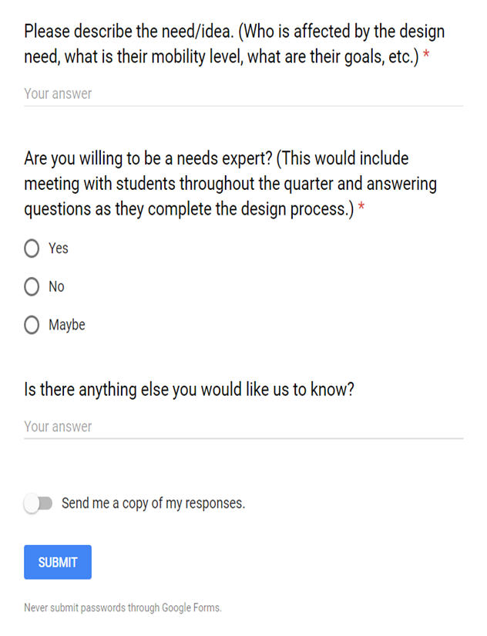
Current State of Survey
Notes:
Wanted to consider breaking down the description into multiple parts; holds user a bit more accountable to fill out info
Needs expert description is accurate but potentially limiting
Love the open ended question at the end

Slide 8
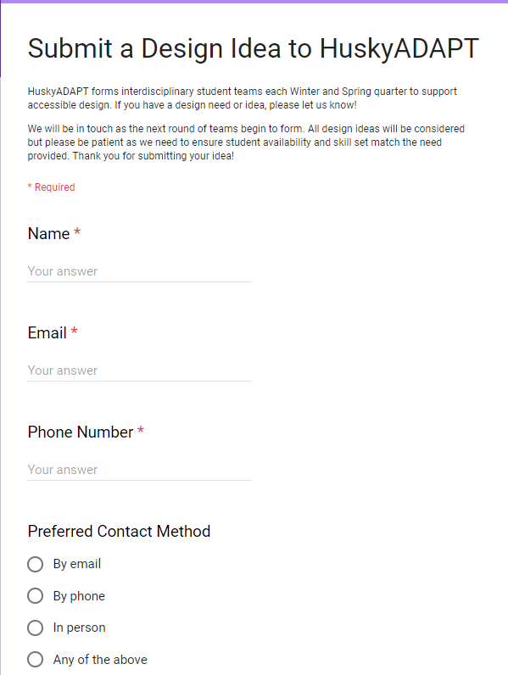
Revised Version
Notes:
Small things here:
Fixed the timeline; Set expectations on return date, wanted to be more specific but found out we couldn’t

Slide 9
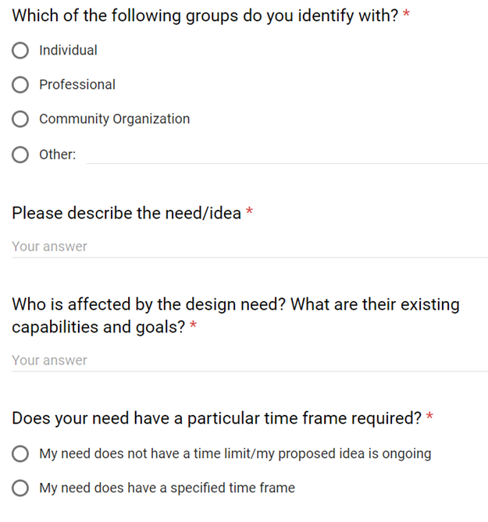
Revised Version
Notes:
The more we know about the person submitting the better
Wanted an overall description of need; asking overlapping questions should induce more detailed responses
What I really want to ask is why is this important but this is a much better way of framing it (understanding goals)
See if the idea is feasible

Slide 10
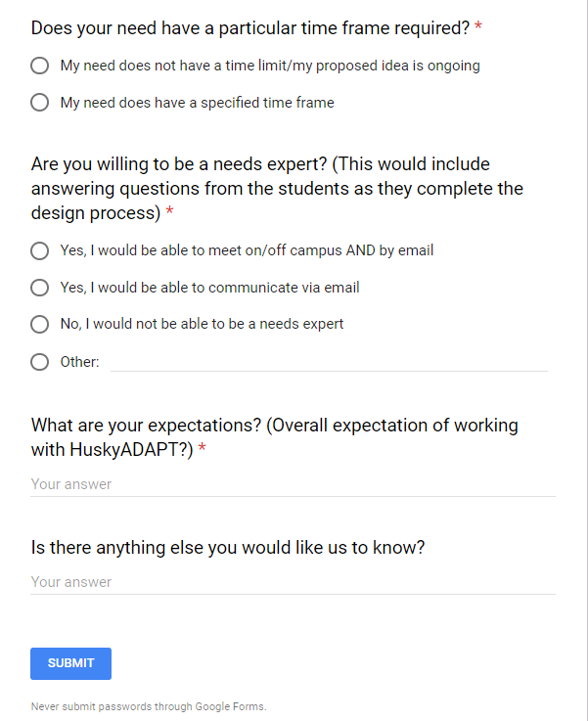
Revised Version
Notes:
This new description of a need expert is more inclusive
Biggest thing I would want to know coming in is expectations
Can manage those before even meeting with group of students; see what is achievable
Left the open ended question, like giving people the opportunity to say more

Slide 11
Next Steps
Incorporate feedback into final design form
Gain access to responses to survey
Add link to design and homepage
Send out survey to groups

